Slide 1
10 things to know about ICPSR

Slide 2
Basics
Based at University of Michigan
Consortium funding model - members pay dues based on Carnegie rating
At Berkeley, D-Lab pays the bill and Jon Stiles is the “OR” and I’m the “DR”
Mission
Share data
Educate and train current and future researchers
Provide data management & curation services
Topical coverage
Over 40 disciplines
Top 10 are Social sciences, Public Administration, Behavioral Sciences, Health, Medical Care, Economics, Education, Humanities, Political Science, Sociology
AY 14-15 UCB usage: 290 unique users -- 3,189 datasets downloaded (375 GB)
Notes:
Note how this contrasts with many emerging "archives" of data that allow submission of datasets with minimal metadata and few quality assurance controls, e.g Dataverse, DASH, FigShare. Promoting ICPSR to faculty (and providing support to them) is an important topic, but out of scope.

Slide 3
2. Usage examples
Example 1: Faculty member needs data to support research on African American teen alcohol consumption trends. We find a data series in ICPSR but her expertise is not in quantitative research, and a lot of prep is required so I provide quick Stata training to her RA
Example 2: Undergraduate in an Economics of Discrimination course wants to write paper on racial disparity in outcomes after the implementation of new criminal sentencing guidelines. Jim and I introduce ICPSR when we present to the class, he finds a dataset on his own but part of it is in an unfamiliar format (SAS) so he comes to the Data Lab to get help converting it and merging it.

Slide 4
3. Record components: Documentation
Two main types of documentation
Codebooks
Technical Documentation
Critical for researchers to look at these to determine the suitability of the data and to find technical information pertinent to using the data
“Setup” files can also help users understand the structure of the data.

Slide 5
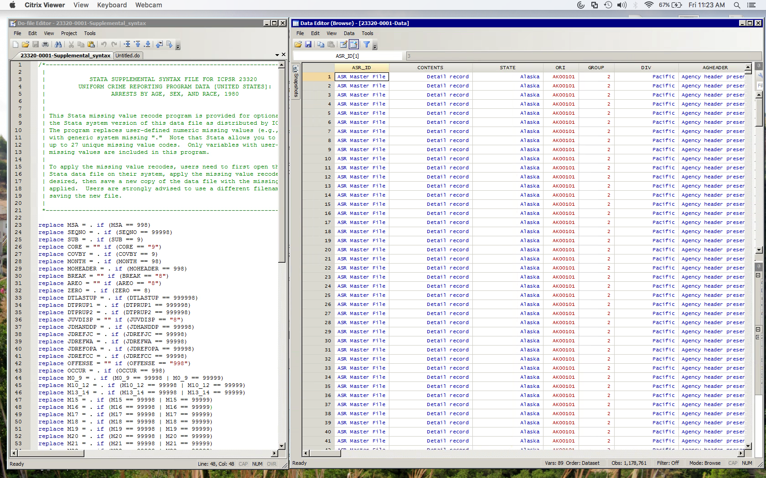
4. Record components: Code and Data
Notes:
Various permutations of processed and unprocessed data and code can be found. Analysis code isn’t curated!

Slide 6
5. There are three types of search
Study
Variable
Literature
Notes:
Navigate to

Slide 7
6. Login required
Users must log in from a UC Berkeley ip address when they create their account.
Subsequent logins can be done anywhere.
Login only required for downloading data - documentation can be accessed without.
Some datasets have further access restrictions and there won’t be any download links. Generally, these data will require proof of IRB approval and perhaps other requirements to gain access to the data.

Slide 8
7. Statistical software requirements
Most datasets have been prepared for use in SAS, SPSS, Stata
Stata and SPSS (soon?) are available on citrix.berkeley.edu (CalNet login required).
SAS, SPSS, Stata, and R are available in the Data Lab and D-Lab.
Help converting from one format to another is available in the Data Lab.
Some can be opened in Excel, but generally it’s not a good idea.
Large size of some files makes it hard to manipulate the data
Metadata like long labels and value labels can’t be used
A large number of files can be analyzed online, but researchers generally use this only for exploratory analysis.

Slide 9
8. Standardized metadata
ICPSR uses a metadata standard called DDI that captures important details about the research process, time, file formats and version, etc.
Makes it easy to find important details without always having to delve into documentation

Slide 10
9. Thematic collections
In addition to archiving data from individual researchers, ICPSR has ongoing partnerships with some government agencies and foundations.
These datasets can be found via a normal search, but they also have their own “collection level” landing pages with additional information. Examples include:
National Archive of Criminal Justice Data
NCAA Student Athlete Experiences Data Archive
Measures of Effective Teaching Longitudinal Database
National Addiction and HIV Data Archive
Teachingwithdata.org
For a full listing of thematic collections see: https://www.icpsr.umich.edu/icpsrweb/content/membership/partners/archives.html

Slide 11
10. Much more!
Summer institutes
Curricular materials
Webinars

